Slide 1
SwiftRide Case Study
Insights Extraction

Slide 2
SwiftRide Synthethic Data
trip_id | rider_id | driver_id | trip_start | trip_duration | fare | surge | driver_rating | traffic | weather | hour | driver_tenure
T001 | R101 | D201 | 1/15/2025 8:30 | 1200 | 25.5 | 1.2 | 4.8 | Heavy | Rain | 8 | 45
T002 | R102 | D202 | 1/15/2025 9:15 | 900 | 18 | 1 | 4.2 | Moderate | Clear | 9 | 120
T003 | R103 | D203 | 1/15/2025 18:45 | 1800 | 42 | 2 | 4.9 | Heavy | Storm | 18 | 15
T004 | R101 | D204 | 1/16/2025 22:00 | 1500 | 35 | 1.5 | 3.5 | Light | Clear | 22 | 200
T005 | R104 | D201 | 1/16/2025 7:50 | 800 | 15 | 1 | 4.7 | Moderate | Fog | 7 | 45
T006 | R105 | D202 | 1/16/2025 17:30 | 1400 | 30 | 1.8 | 4.5 | Heavy | Rain | 17 | 120
T007 | R106 | D203 | 1/17/2025 12:00 | 600 | 12 | 1 | 4.6 | Light | Clear | 12 | 15
T008 | R107 | D205 | 1/17/2025 23:30 | 2500 | 58 | 2.5 | 2.8 | Light | Clear | 23 | 5
T009 | R108 | D201 | 1/18/2025 8:15 | 1100 | 22 | 1.1 | 4.9 | Moderate | Clear | 8 | 45
T010 | R109 | D206 | 1/18/2025 19:00 | 1300 | 28 | 1.3 | 4.4 | Moderate | Clear | 19 | 60

Slide 3
Insights
GROUP trip expenditure BY riderID
GROUP trip revenue BY driverID
etc?
Are they insights?

Slide 4
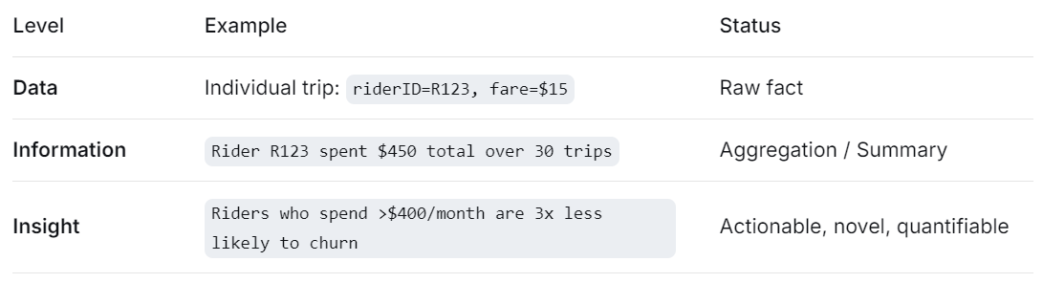
Insights
No, those are not insights by themselves. They are aggregations or summary statistics – the raw output of a GROUP BY query. Then what is an Insight？
The aggregation becomes an insight only when we can compare, correlate, segment, or detect a pattern that leads to a business decision.
An insight requires interpretation, context, and often comparison or anomaly detection.

Slide 5
Turning Simple Aggregations into Insights
GROUP BY riderID (total spend) | Top 10% of riders by spend account for 60% of revenue → prioritize retention offers for this segment.
GROUP BY riderID (avg rating given) | Riders who consistently rate drivers <3 stars have 80% higher churn → investigate if poor driver matching is the cause.
GROUP BY driverID (total revenue) | Drivers in the bottom 20% of earnings work during low‑demand hours → suggest shift changes.
GROUP BY driverID (avg rating received) | Drivers with rating <4.0 have 5x higher churn → trigger coaching after three consecutive low ratings.

Slide 6
Turning Simple Aggregations into Insights
Is it non‑obvious?
Is it actionable?
Does it include a comparison or threshold?

Slide 7
Turning Simple Aggregations into Insights
Trivial insight (still just information): Rider R05915 spent $320 on 22 trips. Driver D04746 earned $1,450 over 180 trips.
Valuable insight: *Riders who spend >$400/month have 70% higher retention than those who spend <$100/month, suggesting a loyalty program targeting mid‑to‑high spenders could reduce churn.* *Drivers who earn <$500/week and have rating <4.2 are 90% likely to leave within 30 days → prioritize these drivers for incentives.*

Slide 8
Does a Heatmap Help Determine Valuable Insights?

Slide 9
Does a Heatmap Help Determine Valuable Insights?
Yes, a heatmap (especially a correlation heatmap) is a powerful visual screening tool to identify potentially valuable pairwise relationships. However, it does not automatically tell you which insights are truly valuable—it only highlights statistical associations that deserve further investigation.
Suppose, if heatmap shows driver_tenure < 30 days and low rating in rain (correlation -0.62).
That’s valuable only after data confirm that training new drivers for weather conditions improves ratings (diagnostic + prescriptive).
A heatmap never determines value – it points to where value may hide.

Slide 10
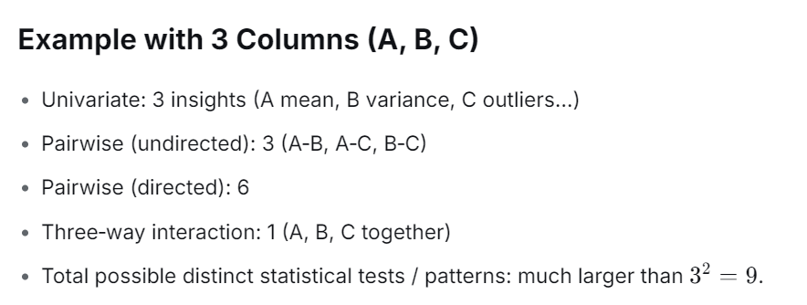
How many insights really exists within the data?
Type of Pairwise Comparison |  | For 18 Columns
Undirected pairs (e.g., correlation between A and B) | n(n-1)/2 | 153
Directed pairs (e.g., A → B vs B → A count separately) | n(n-1) | 306
Including self‑pairs (e.g., A with A – usually trivial) | n^2 | 324

Slide 11
DIKW mapping
Level | Example
Data | Raw trip record: (T003, R103, D203, 2025-01-15 18:45, 1800 sec, $42, surge 2.0, rating 4.9, Heavy traffic, Storm, hour 18, driver tenure 15 days)
Information | Trips during evening rush hour (5-7 PM) have average surge 1.8× and 40% longer duration than daytime trips.
Knowledge | Drivers with tenure < 30 days have 3× more low ratings (≤ 3.5) during storm conditions, suggesting insufficient training for adverse weather.
Wisdom | Implement mandatory weather‑driving simulation training for new drivers; offer incentive bonuses for drivers who accept trips during storms to reduce surge and improve rider satisfaction.

Slide 12
Insight Extraction
a) Trivial insight: Surge pricing is higher during bad weather.
b) Valuable insight: New drivers (tenure < 30 days) receive significantly lower ratings (avg 3.2) during rain/storm compared to experienced drivers (avg 4.7), but their trip acceptance rate is similar. This indicates a training gap, not a motivation gap.
Why valuable:
Actionable – training can be implemented.
Novel – not obvious that new drivers struggle specifically in weather.
Quantifiable – rating difference of 1.5 points.
Timely – can reduce driver churn and rider complaints quickly.

Slide 13
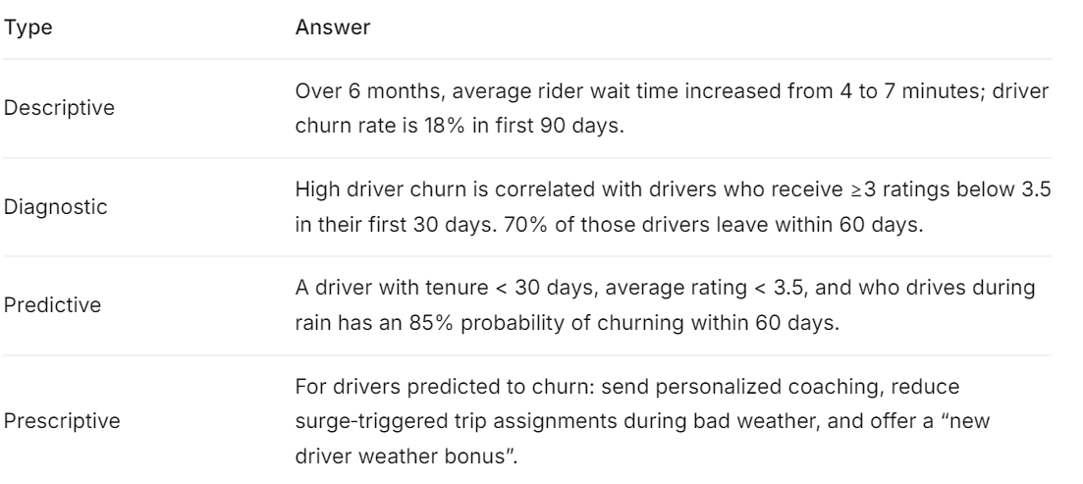
Analytics Types

Slide 14
KPIs - for Driver satisfaction, rider engagement, operational efficiency, and financial performance.
Average driver rating received during the first 30 days of active driving.
Percentage of active riders who complete at least one trip in a given calendar week.
(Increase in driver supply during surge) / (Increase in fare per trip) – measures how effectively surge pricing balances supply and demand.
Average number of days a driver remains active on the platform from their first completed trip to their last trip.

Slide 15
KPIs
Percentage of riders who sign up and complete at least one trip in their first 7 days, and then complete another trip within the following 7 days.
Percentage of trip requests accepted by a driver out of all requests sent to that driver within a given period (e.g., daily or weekly).
The 95th percentile of time elapsed from ride request to driver arrival at pickup location, measured in minutes. Lower is better.
Average gross fare earned by a driver divided by the number of hours they are online and available for trips (excluding idle time with no requests).

Slide 16
KPIs
Percentage of accepted trips that are successfully completed (not cancelled by driver or rider after acceptance).
Average gross fare contributed by a rider over their first 6 months of active use of the platform.
Average increase in driver rating within 14 days after receiving a coaching intervention (e.g., low rating alert).
(Actual number of drivers online during defined peak hours) / (Target number of drivers needed to meet demand without surge >1.5).

Slide 17
SMART KPIs
Criterion | Statement
Specific | Increase the average driver rating for drivers in their first 30 days from current 3.8 to 4.5.
Measurable | Rating data collected after every trip; average computed weekly.
Achievable | Pilot program with 100 new drivers showed average rating 4.4 after weather training.
Relevant | Directly linked to driver retention and rider satisfaction.
Time-bound | Achieve 4.5 average rating for new drivers within 4 months of implementing training program.

Slide 18
Insight
Trips cost more when surge multiplier is higher.
Longer trips have higher fares.
Rush hour (5–7 PM) has more trips than late night.
Rainy weather increases trip duration due to traffic.
Drivers with higher ratings get more trip requests.
Weekend nights (Friday/Saturday 10 PM–2 AM) have higher surge.
Airport trips have higher average fares.
New drivers have fewer completed trips than experienced drivers.
Surge pricing is higher when demand exceeds supply.
Riders with longer tenure use the app more frequently.
Heavy traffic increases trip time.
Cash payments are more common in certain neighbourhoods.
Drivers who work more hours earn more.
Storm weather reduces total trip volume.
Late-night trips have higher surge than midday.

Slide 19
Strategic Decision
Decision: Launch a “New Driver Weather Academy” – a mandatory 2‑hour simulation‑based training module for all drivers with tenure < 30 days, focusing on safe and efficient driving in rain, fog, and storm conditions. Additionally, introduce a “Weather Hero” bonus (extra $5 per trip) for new drivers who accept rides during adverse weather and maintain rating ≥ 4.0.
Implementation:
Training integrated into driver onboarding app.
Bonus automatically applied via real‑time event processing.
Success measurement:
Compare 30‑day driver ratings and churn rates before/after intervention.
Target: 30% reduction in new‑driver churn within 3 months.
Monitor rider wait times during weather events (should decrease as more drivers stay online).

Slide 20
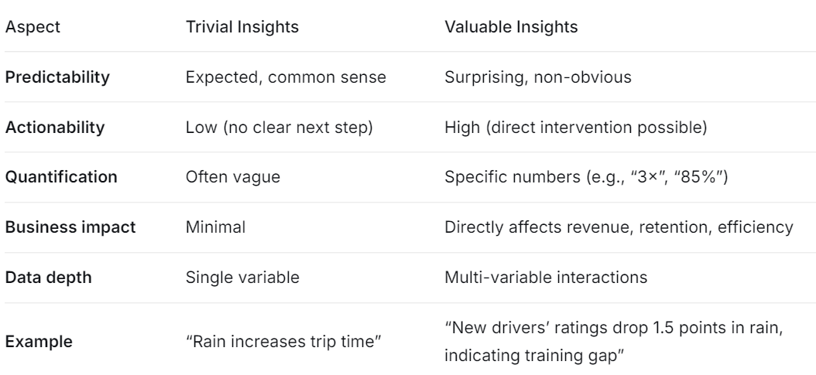
Summary

Slide 21
reading for next class
Self Exploration
https://www.datacamp.com/tutorial/what-is-a-parquet-file
https://www.nyc.gov/site/tlc/about/tlc-trip-record-data.page

